Slide 2
Q1 2015 Acquisition Marketing Recap
May 8 2015

Slide 3
Marketing Lingo
LTV = Lifetime Value
SEO = Search engine optimization
PPC = Pay per click search engine marketing
Brand = Ad campaigns that contains keywords like “opentable”, “open”, etc…
NonBrand = Ad campaigns that do not contain Brand names e.g. “Restaurants near Empire State Building”
Restaurant = Ad campaigns that contain the restaurant’s name e.g. “Perbacco”
Mobile = Mobile app install marketing
Affiliates = Affiliates and partners marketing
Email = Email marketing
Display = Banner ad retargeting and prospecting
Retargeting = Ad campaigns where we retarget users who have already seen our ads somewhere else
Prospecting = Ad campaigns where we target new users we have never reached out to yet
Restaurant Week = Restaurant week marketing
Social = Social media marketing including Facebook and twitter
Cost Per Booking = PPC Cost / PPC Bookings
Cost Per Booker = Mobile Cost / Mobile Bookers
Notes:
26% of Network bookings

Slide 4
Executive Summary
Marketing accounted for 29% of total bookings in Q1 2015, that’s 42% of Network bookings.
80% of Marketing bookings come from 1) SEO, 2) PPC, 3) Affiliates
We spent close to $5M in PPC (Paid Search) and are nearing a positive ROI at 0.99.
The Google 3-Pack and our larger focus on PPC is creating a mix shift in our bookings and making us more reliant on Google. Currently, SEO and Affiliates is non-paid whereas PPC is paid.
Projections for Spend and Revenue for Q2 are set lower but this is because we expect quarterly seasonality as we’ve historically seen in our business.
Continuing to try and understand how each marketing channel interacts with one another (multi-touch attribution).
Notes:
26% of Network bookings

Slide 5
Executive Summary per Marketing Channel
SEO: We are seeing strong mobile web traffic growth and a shift in our audience from desktop to mobile but mobile still converts lower. Linkbuilding (reaching out to other websites to link back to us) is helping us rank better in Google search results.
PPC: We continue to see bookings scale while becoming more efficient with our spending across all markets. Our Brand ROI is strong and so we are funding NonBrand and Restaurant PPC off of this success. ROI in NAM is 1.58. We’re currently sending PPC traffic to generic pages for Points Of Interest (POI) landing pages and yet we saw 11,000+ bookings off of less than 250 POIs. Launching 150k optimized POI landing pages and expecting to see good results starting end of May.
Mobile: We reached a record $15 Cost per Booker while still seeing good volume in NAM. Only 4% mobile app adoption in UK means we should try fun and innovative campaigns. Mobile Retargeting whereby we send push notifications to users who have the app is very promising as it helped generate incremental bookings with a 1.05 ROI in NAM for users who installed the app but never even made a booking yet.
Display: We are starting to see bookings scale while becoming more efficient with our spending across all markets.
Affiliates: We are seeing good YoY growth in all markets except Germany which remains a challenge. It will be interesting to look at results next quarter with the loss of both Yelp and Urbanspoon as affiliates.
Restaurant Weeks: More focus on Restaurant Weeks this quarter with a +11.8% YoY growth in OpenTable Restaurant Week bookings. Restaurant Week PPC bookings scaled 3x YoY with a better efficiency now at $1.63, and still plenty of room to improve.
Social: Tested targeted Twitter campaigns driving 4,040 app installs, 1,911 unique bookers and a $9.36 Cost per Booking.
Notes:
26% of Network bookings

Slide 6
Discussion and Feedback
Overall, positive feedback from the executive staff!
Most of those who were present had already pre-read the deck before the meeting and so instead of reading through each slide, we had a discussion-based meeting.
Discussion was based around:
Incrementality How much do we think Marketing is contributing in addition to underlying trend and seasonality? How much can we attribute this additional revenue to Marketing?
Multi-Touch Attribution Close to 15% of users who make a booking via one of our Marketing channels interacts with more than just 1 channel e.g. clicked on PPC ad via NonBrand query, then search for a restaurant and made a booking via Google Affiliate.
Opportunities the Acquisition Marketing team is excited about Spend more on PPC, send PPC traffic to new POI landing pages, focus more on Mobile Retargeting and Display, and Facebook advertising.
Challenges the team faces What are the big opportunities where we can scale?
Notes:
26% of Network bookings

Slide 7
Marketing accounts for 29% of total bookings
42% of Network bookings
Marketing excluding SEO accounts for 19%

Slide 8
Q1 2015 Marketing Summary
Channel | Spend | Spend % | Bookings | Bookings % | Mobile Installs | Q1 Revenue | Q1 ROI
PPC | $4,942,171 | 65% | 1,662,777 | 23% | 5,022 | $6,501,581 | 0.99
Affiliates | $1,076,920 | 14% | 1,649,834 | 23% | NA | $5,308,679 | 3.70
Mobile | $615,077 | 8% | 185,502 | 3% | 157,480 | $558,321 | 0.68
Display | $497,197 | 6% | 179,888 | 3% | NA | $629,827 | 0.95
Email | $253,812 | 3% | 625,315 | 9% | 47,718 | $2,044,023 | 6.04
Restaurant Week | $199,750 | 3% | 376,264 | 5% | NA | $1,076,114 | 4.04
Social | $44,462 | 1% | 18,867 | 0.30% | 4,354 | $54,136 | 0.91
SEO | $27,668 | 0% | 2,414,894 | 34% | 59,964 | $7,754,007 | 210
Total | $7,657,056 | 100% | 7,113,341 | 100% | 274,538 | $23,926,688 | 2.52
Total w/o SEO | $7,629,388 |  | 4,698,447 |  | 214,574 | $16,172,681 | 2.12
* Methodology for Mobile reporting changed since last quarter

Slide 9
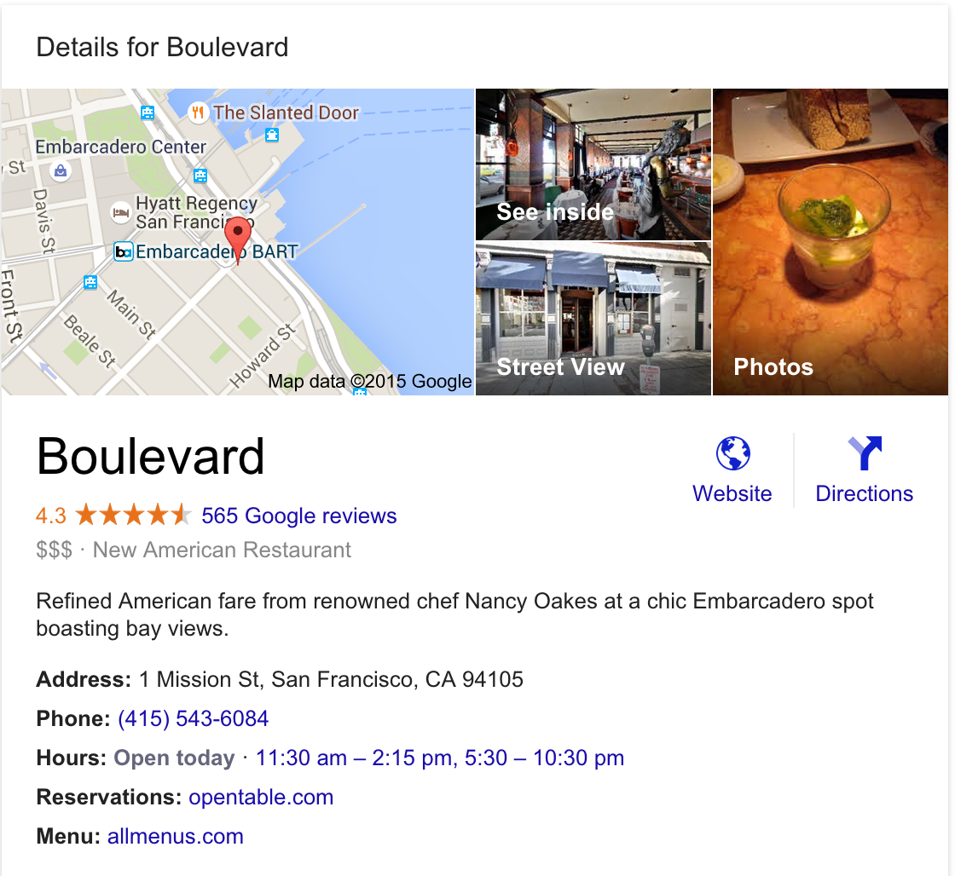
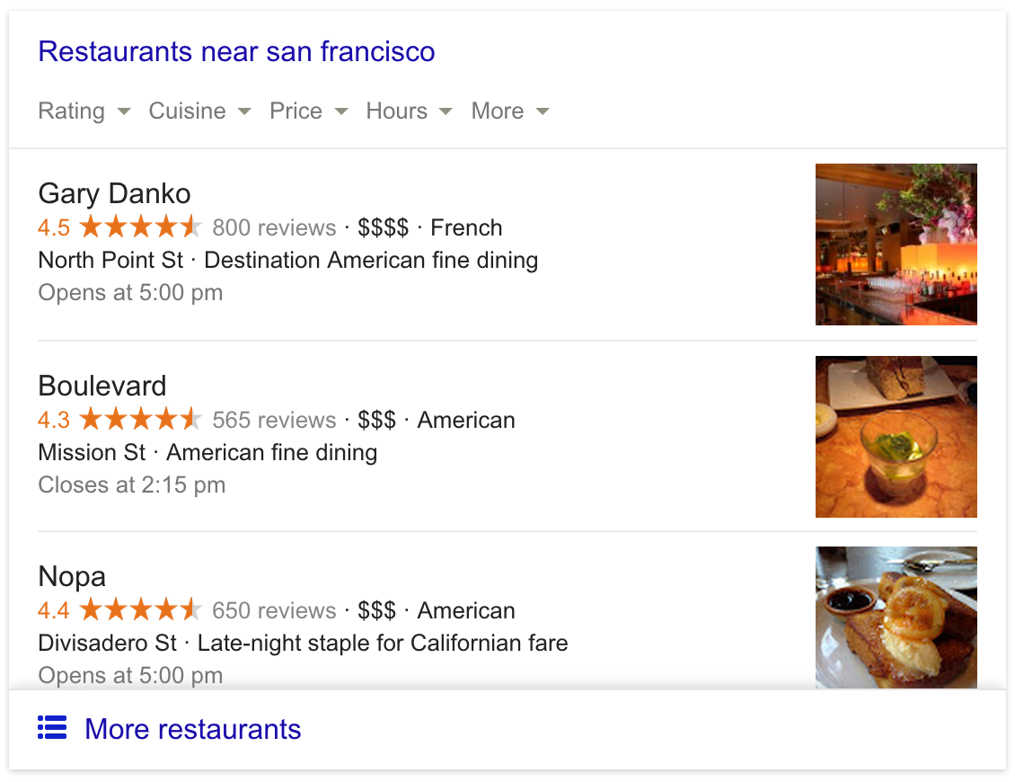
Google 3-Pack
In Nov 2014, Google introduced the 3-Pack in search results pages. When users click through to the opentable.com link and make a booking, they are counting towards our Affiliates program.
Fortunately, we do not pay Google for this Affiliate program.
Because of this, and in addition to our greater focus on Paid Search, we are seeing a mix shift in our bookings.
Notes:
26% of Network bookings

Slide 10
NAM Google Bookings Mix Shift (SEO, PPC, Affiliate)
Google bookings grew 33% YOY (Google SEO, PPC, Affiliate), representing 18% of total bookings
Significant mix shift from Google SEO to Affiliate and PPC given 3-pack launch mid-Nov 2014 and brand PPC ramp-up
Notes:
26% of Network bookings

Slide 11
SEO
We are seeing strong mobile web traffic growth and a shift in our audience from desktop to mobile but mobile still converts lower.
Linkbuilding (reaching out to other websites to link back to us) is helping us rank better in Google search results.
Notes:
26% of Network bookings

Slide 12
SEO growth despite mix shifts
SEO traffic up YoY with significant growth in mobile (+64%) even with substantial changes in search results including 3-pack and local listings on Google
Redesign launch successful from an SEO point of view, neutral to positive impact on Q1 results

Slide 13
SEO Desktop vs. Mobile
Strong mobile web traffic growth and shift in audience to mobile but mobile converts lower

Slide 14
Ranking with and without Linkbuilding
Continued visibility improvement in key markets per linkbuilding outreach strategy including our first #1 ranking in a major market ("NYC restaurants")

Slide 15
PPC
We continue to see bookings scale while becoming more efficient with our spending across all markets.
Our Brand ROI is strong and so we are funding NonBrand and Restaurant PPC off of this success. ROI in NAM is 1.58.
We’re currently sending PPC traffic to generic pages for Points Of Interest (POI) landing pages and yet we saw 11,000+ bookings off of less than 250 POIs. Launching 150k optimized POI landing pages and expecting to see good results starting end of May.
Notes:
26% of Network bookings

Slide 16
PPC Highlights and Lowlights
Highlights
Restaurant weeks saw huge NonBrand growth with 30,000 reservations
POIs drove 11,000+ reservations in Q1. Developed a new methodology for importing mass amounts of POIs.
Ramped for Holidays, with Valentine’s Day terms bringing in 30,000+ reservations
Built out all restaurant terms in Germany and Japan
Lowlights
Data Tracking – pulling in Kenshoo data into Microstrategy
3 pack and other Google changes making CPCs more expensive
Landing Pages and Mapping
Mobile App Tracking – losing visibility to smart app banner

Slide 17
Global PPC ROI at 0.99
We are funding growth in NonBrand and Restaurant PPC off of the success of Brand PPC
PPC ROIs | NAM | UK | DE | JP
Brand | 6.18 | 5.03 | 7.31 | 4.53
NonBrand | 0.34 | 0.46 | 0.23 | 0.13
Restaurant | NA | 0.66 | 0.43 | 0.65
Total | 1.58 | 0.68 | 0.43 | 0.76

Slide 18
Q1 2015 PPC bookings increased +88% YoY

Slide 19
New vs. Active PPC Bookings
Paid Search contributed 9% of New/FirstTimeOT/Lapsed users to the network (4% for the company)

Slide 20
NAM PPC NonBrand volume grew 30% YoY
Ramped restaurant weeks which contributed to 13% of NonBrand bookings

Slide 21
UK PPC total volume grew +64% YoY
Ramped spending for holidays and aggregated over 2,000 Valentine’s Day reservations
87% of restaurants are opted in, the remaining 13% are black-listed

Slide 22
DE PPC total volume grew +123% QoQ
Focused on optimizing new account - large focus on DSA campaign and restaurant builds
82% of restaurants are opted in, the remaining 18% are black-listed

Slide 23
Japan PPC volume grew +183% YoY
Grew our mobile presence and built out all Japan restaurants

Slide 24
Q2 2015 PPC Timeline
Launch Ad Testing Tool in NA/UK/DE
Launch New Restaurant Management Strategy for DE/UK
5/18/2015
6/29/2015
Launch New Bidding Strategy Test in DE
Launch DSA Bidding in NA/UK/DE
5/4/2015
6/15/2015
Launch POI Head Term & RLSA Test in NA
Launch 100k+ in NA/UK POI's
4/20/2015
5/25/2015
April
May
June
4/24/2015
6/1/2015
Launch Cuisine Head Term Test in NA
Begin KW & SQR Expansion via Tool in NA/UK/DE
4/13/2015
Launch NA Restaurant Test

Slide 25
Mobile
We reached a record $15 Cost per Booker while still seeing good volume in NAM.
Only 4% mobile app adoption in UK means we should try fun and innovative campaigns.
Mobile Retargeting whereby we send push notifications to users who have the app is very promising as it helped generate incremental bookings with a 1.05 ROI in NAM for users who installed the app but never even made a booking yet.
Notes:
26% of Network bookings

Slide 26
Mobile App Penetration Per Market
Still remarkable upside to get users to adopt mobile app
Mobile App Users grew +27% YoY

Slide 27
NAM App Installs Distribution

Slide 28
NAM continues to try to deliver against CPBooker efficiency while scaling
Early Q1 results have us hitting $15 CPBooker, which is the lowest we’ve seen yet.

Slide 29
UK App Installs Distribution

Slide 30
We scaled back spend and tried to focus on efficiency because CPBooker have been difficult to deliver against
Focused on mobile retargeting in Q1

Slide 31
Mobile Retargeting is changing the game
NAM 29% of total Mobile Spend went into Mobile retargeting and 13% of UK
NAM | Spend ($) | Bookings | Cost Per Booking ($) | ROI
New App Users* | $59,229 | 28,856 | $2.05 | 1.05
Existing App Users* | $90,036 | 146,499 | $0.61 | 3.49
Total App Users | $149,265 | 175,355 | $0.85 | 2.52
UK | Spend ($) | Bookings | Cost Per Booking ($) | ROI
New App Users | $5,338 | 368 | 14.51 | 0.43
Existing App Users | $6,594 | 3,981 | 1.66 | 3.79
Total App Users | $11,932 | 4,349 | 2.74 | 2.29
* New App Users: User has the app but never made a booking (dormant state)
* Existing App Users: User has the app and has already made at least 1 booking

Slide 32
Display
We are starting to see bookings scale while becoming more efficient with our spending across all markets.
Notes:
26% of Network bookings

Slide 33
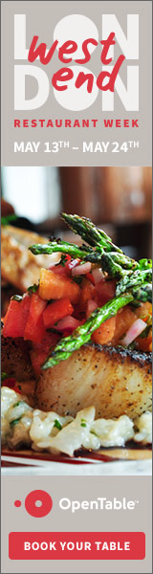
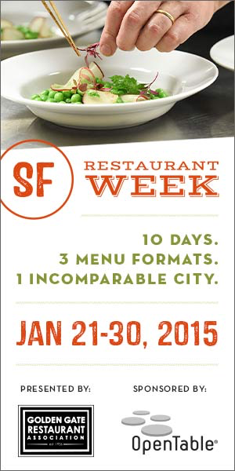
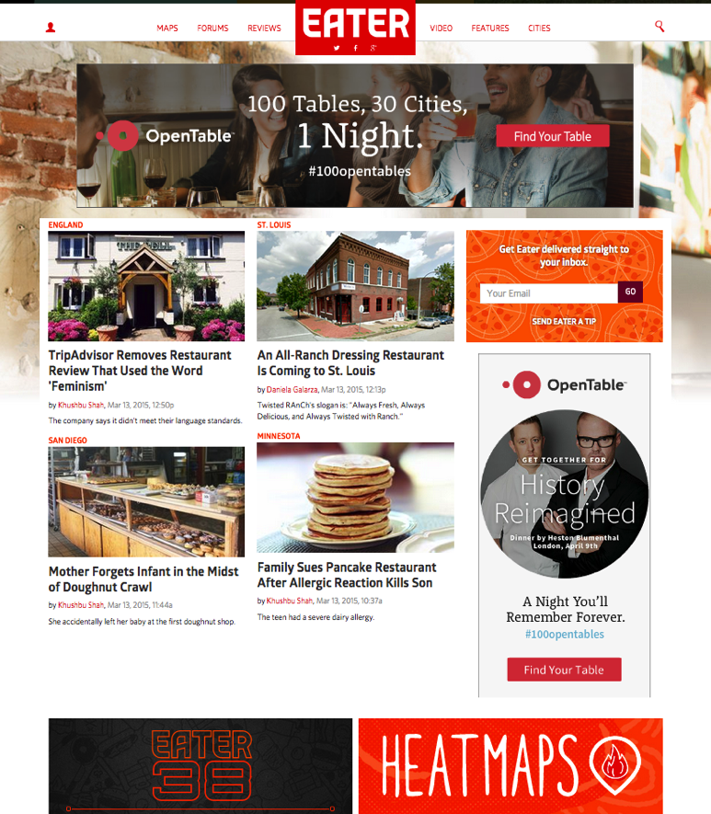
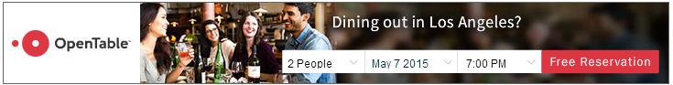
Display Campaigns

Slide 34
Global Display Campaigns
Introduced dynamic advertising (Criteo) driving higher click conversions across all countries
Creative brand redesign driving higher click-through rates and engagement

Slide 35
NAM Display Campaigns
Started buying direct sites via programmatic (PMP) e.g. Conde Nast, Eater, weather.com, etc..
Launched #100opentables brand campaign

Slide 36
UK Display Campaigns
Streamlined creative and introduced a suite of new creatives
We focused on retargeting with MediaMath and Criteo while driving highly effective prospecting

Slide 37
DE Display Campaigns
We introduced dynamic advertising driving much higher efficiencies in overall conversions
Full focus on retargeting

Slide 38
Affiliates
We are seeing good YoY growth in all markets except Germany which remains a challenge.
It will be interesting to look at results next quarter with the loss of both Yelp and Urbanspoon as affiliates.
Notes:
26% of Network bookings

Slide 39
NAM Affiliates Bookings
Overall, NA affiliates in Q1 2015 grew +75% YoY, driven by positive growth in all top 5 affiliates (excluding Urbanspoon/Zomato). The top 5 drive 90%+ of total bookings.

Slide 40
NAM Top 5 Affiliates
Google’s bookings grew by +130% YoY due to Google 3-Pack in Nov 2014 causing channel mix shift.
Bing introduced Bing Local with the OpenTable affiliate link in their search results, driving +160% YoY quarter growth.

Slide 41
UK Affiliates Bookings
In Q1, UK bookings grew 67% YoY, driven by strong Affiliate programs via Google and TripAdvisor

Slide 42
UK Top 5 Affiliates

Slide 43
DE Affiliates Bookings
Speisekarte continues to be primary driver

Slide 44
DE Top 5 Affiliates

Slide 45
JP Affiliates Bookings
Japan continues to grow despite risk that Tabelog represents 99% of Affiliate bookings

Slide 46
JP Top 5 Affiliates

Slide 47
Restaurant Weeks
More focus on Restaurant Weeks this quarter with a +11.8% YoY growth in OpenTable Restaurant Week bookings.
Restaurant Week PPC bookings scaled 3x YoY with a better efficiency now at $1.63, and still plenty of room to improve.
Notes:
26% of Network bookings

Slide 48
Restaurant Week Bookings
Q1 2015 RW bookings grew +5.2% YoY, OpenTable bookings grew +11.8%
Increased number of events from 55 to 62 events

Slide 49
Q1 2015 Restaurant Week Bookings
Email remains a key driver for Restaurant Week bookings
Strong results from PPC and Display campaigns

Slide 50
RW PPC Channel Performance
Restaurant Week PPC bookings scaled 3x YoY with a better efficiency now at $1.63
Conversion Rate increased from 23.6% to 25.1%, signaling better targeting

Slide 51
Social
We tested targeted Twitter campaigns driving 4,040 app installs, 1,911 unique bookers and a $9.36 Cost per Booking.
Notes:
26% of Network bookings

Slide 52
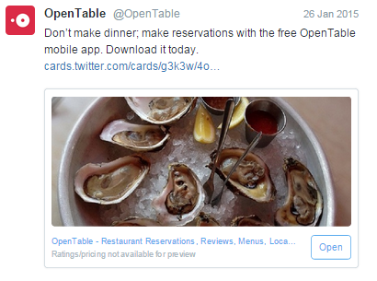
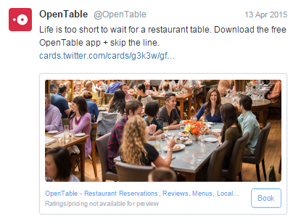
NAM Twitter Campaigns
Tested targeted Twitter campaigns driving 4,040 app installs, 1,911 unique bookers and a $9.36 Cost per Booking

Slide 53
Q2 2015 Marketing Summary
Channel | Spend | Spend % | Bookings | Bookings % | Q2 Revenue | Q2 Net ROI
PPC | $4,834,613 | 60% | 1,477,768 | 24% | $4,514,796 | 0.93
Affiliates | $1,030,588 | 13% | 1,565,597 | 25% | $5,054,353 | 4.90
Mobile | $992,594 | 12% | 340,350 | 5% | $792,674 | 0.80
Display | $830,135 | 10% | 204,202 | 3% | $791,706 | 0.95
Email | $228,971 | 3% | 609,007 | 10% | $1,907,739 | 8.33
Social | $67,875 | 1% | 21,750 | 0% | $75,623 | 1.11
Restaurant Week | $50,000 | 1% | 43,000 | 1% | $122,980 | 2.46
SEO | $23,173 | 0% | 2,005,104 | 32% | $6,318,649 | 272
Total | $8,057,949 | 100% | 6,266,777 | 100% | $19,578,522 | 2.43
Total w/o SEO | $8,034,776 |  | 4,261,674 |  | $13,259,873 | 1.65

Slide 55
OpenTable Marketing Terminology
LTV = Lifetime Value
PPC = Pay per click search engine marketing
Mobile = Mobile app install marketing
Media Campaign = Campaign supporting change from toptable to OpenTable UK
Affiliates = Affiliates and partners marketing
Email = Email marketing
Display = Banner ad retargeting and prospecting
SEO = Search engine optimization
Social = Social media marketing including Facebook and twitter
Cost Per Booking = PPC Cost / PPC Bookings
Cost Per Booker = Mobile Cost / Mobile Bookers
Brand vs. NonBrand vs. Restaurant

Slide 56
Marketing @OpenTable
Prior to 2013, low investment in performance marketing due to inability to find scale with direct ROI >1 (NAM avg. revenue/seated reservation = $2.86)
Business in NAM benefited from strong organic and restref traffic growth; marketing focused on email and restaurant weeks
In 2013, built a performance marketing organization to understand economics and scale of investments in different marketing channels
Still in learning and scaling process

Slide 57
Our Marketing Payback Model
Our per reservation economics have driven us to look differently at how we value marketing return
In addition to Cost Per Booking optimization, we look at a time-to-payback model against a 10-year lifetime value (LTV) instead of direct ROI
Model looks at how many years it takes from the time of spend to “pay back” the marketing investment;
For PPC – Model gives full credit to the future lifetime value of newly acquired bookers and the direct revenue from existing bookers acquired in the campaign
For Mobile – Model gives full credit to the future lifetime value of newly acquired bookers and ALL the revenue from future incremental bookings of existing bookers

Slide 58
Q1 2015 Linkbuilding Results NAM
Keyword | Search Volume | Q3 2013 | Q4 2013 | Q1 2014 | Q2 2014 | Q3 2014 | Q4 2014 | Q1 2015 | Change
atlanta restaurants | 18,100 | 5 | 5 | 3 | 3 | 3 | 6 | 3 | +2
baltimore restaurants | 9,900 | 2 | 2 | 3 | 11 | 7 | 7 | 6 | -4
boston restaurants | 12,100 | 10 | 10 | 8 | 8 | 8 | 2 | 3 | +7
chicago restaurants | 22,200 | 1 | 3 | 5 | 7 | 5 | 3 | 3 | -2
dallas restaurants | 12,100 | 2 | 3 | 4 | 5 | 2 | 4 | 2 | +0
denver restaurants | 12,100 | 4 | 6 | 6 | 6 | 7 | 4 | 5 | -1
houston restaurants | 14,800 | 6 | 8 | 7 | 10 | 10 | 6 | 7 | -1
las vegas restaurants | 18,100 | 2 | 2 | 6 | 7 | 7 | 7 | 4 | -2
los angeles restaurants | 4,400 | 11 | 7 | 6 | 10 | 7 | 8 | 8 | +3
miami restaurants | 9,900 | 5 | 4 | 5 | 4 | 3 | 3 | 2 | +3
minneapolis restaurants | 9,900 | 4 | 4 | 6 | 9 | 8 | 8 | 3 | +1
new orleans restaurants | 27,100 | 15 | 18 | 21 | 17 | 15 | 9 | 6 | +9
nyc restaurants | 12,100 | 11 | 15 | 7 | 6 | 2 | 4 | 1 | +10
philadelphia restaurants | 12,100 | 9 | 11 | 9 | 8 | 6 | 2 | 3 | +6
portland restaurants | 12,100 | 9 | 10 | 12 | 13 | 11 | 8 | 5 | +4
san diego restaurants | 12,100 | 11 | 14 | 14 | 12 | 11 | 6 | 4 | +7
san francisco restaurants | 12,100 | 11 | 6 | 3 | 4 | 2 | 4 | 3 | +8
seattle restaurants | 14,800 | 6 | 9 | 9 | 9 | 10 | 6 | 5 | +1
vancouver restaurants | 1,600 | 7 | 8 | 9 | 9 | 8 | 5 | 5 | +2
washington dc restaurants | 5,400 | 7 | 7 | 7 | 7 | 6 | 6 | 5 | +2

Slide 59
Q1 2015 Gifts PPC grew +160% YoY

Slide 60
Appendix
Display
Biggest milestone achievement in Q1
Audience Targeting: Retargeting changed the game (Criteo in US & UK -- Average 60/40 split in targeting)
Creative Optimizations: New brand advertising and widget creative increased CTR from .03 to .1% by end of Q1. Creative optimization opportunities are vast and will continue to increase (i.e. FlashTalking ads coming in Q2)
Primary Q2 goal/objective
Expand Dynamic Advertising internationally and launch across UK (then Germany and Japan)
Scale Dynamic creatives (outside of Criteo). For UK, speak to audience differently (i.e. Utilize feeds to showcase “offers” in ads)
Utilize Data: 1st party
Increase CTR by 20%. Goal: 285k bookings.

Slide 61
Scaling Display with retargeting
We introduced dynamic advertising driving much higher efficiencies in overall conversions
Full focus on retargeting
Cost Per Booking = Display Cost / Display Bookings
Notes:
Non Brand $9.52 Cost Per Booking for Q4 2014

Slide 62
RW OpenTable bookings per channel
PPC has promising results: 30k bookings at 25.10% conversion rate and $1.63 CPA
SEO/Direct down due to Redesign: a) placement of promo carousel and b) tracking issues

